Slide 1
Nasdanika WebTest
Modular functional testing
of Web and Mobile Applications
November 2014
Selenium Web Driver * JUnit * OSGi

Slide 2
Overview
Functional testing framework built on
Selenium WebDriver
JUnit
OSGi/Equinox
Implicit screenshot capturing
Report generation with screenshots organized into slide-shows
Actor and page classes to facilitate reuse and address device/browser variability

Slide 3
Report Structure
http://www.nasdanika.org/examples/test-report/#router/main/content/summary.html

Slide 4
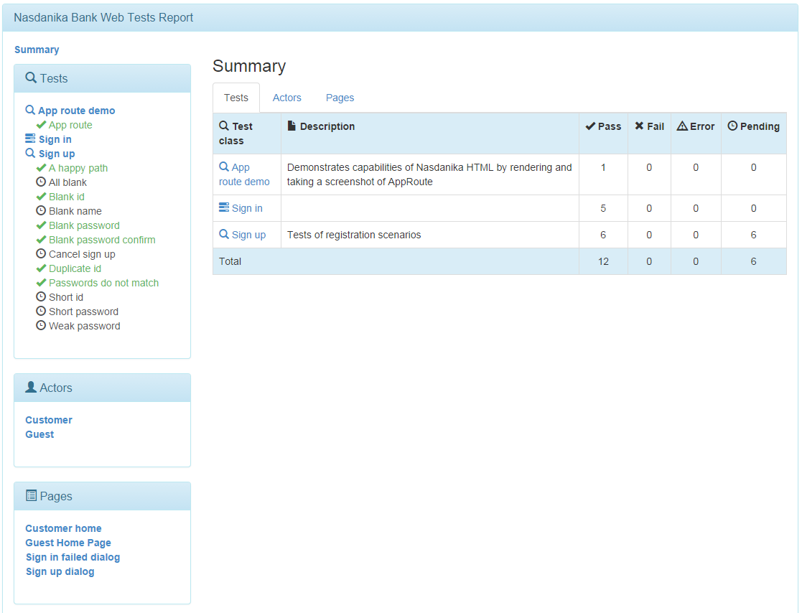
Summary, Test Coverage

Slide 5
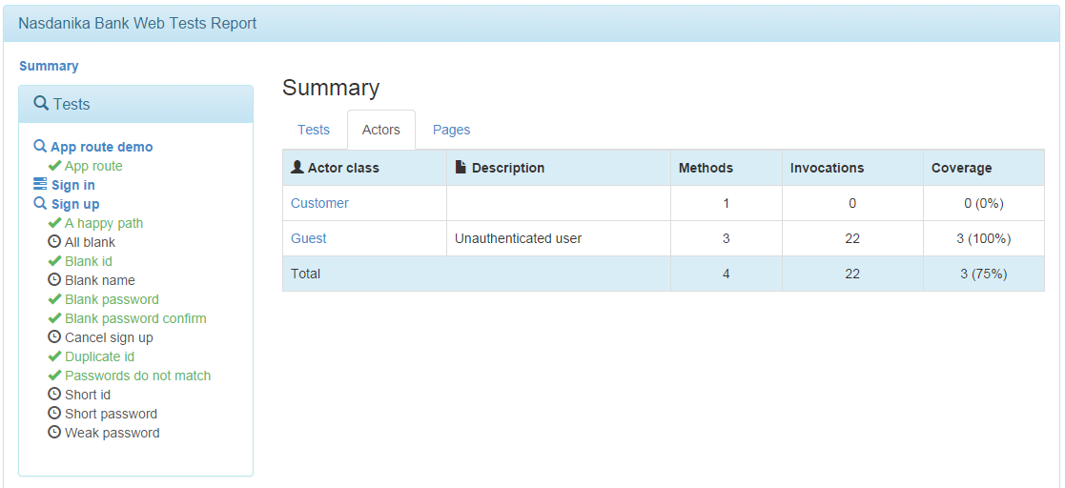
Actor Coverage

Slide 6
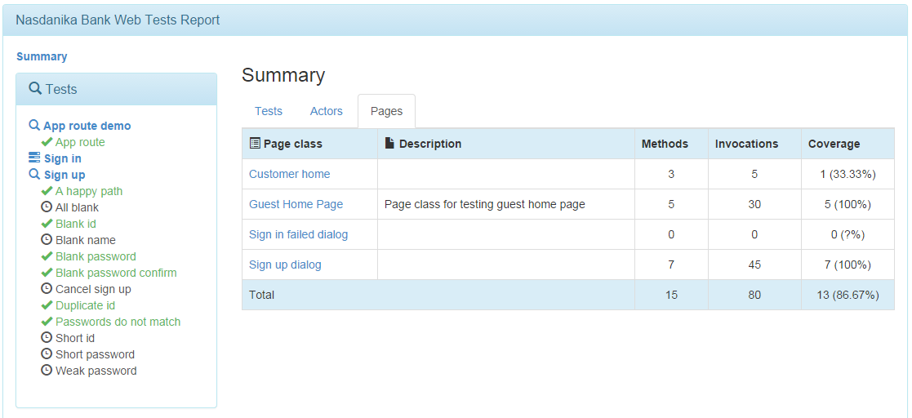
Page Coverage

Slide 7
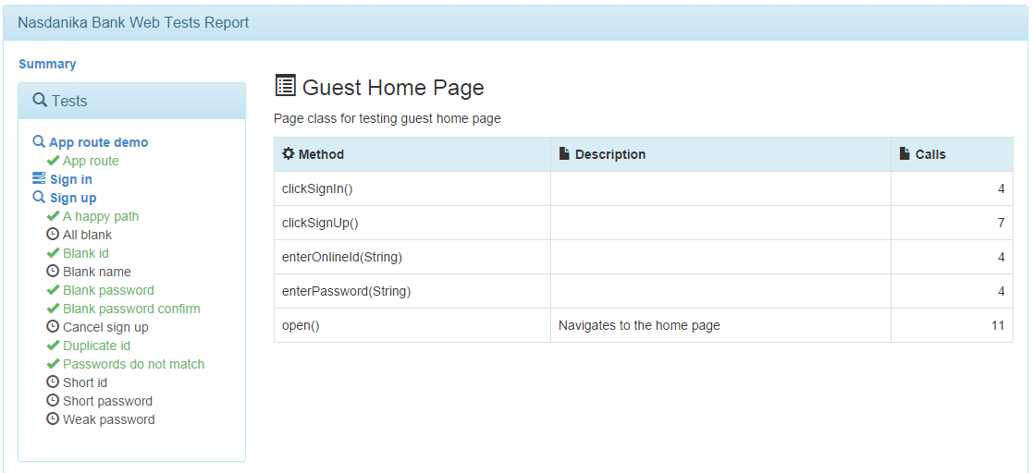
Page Class Details

Slide 8
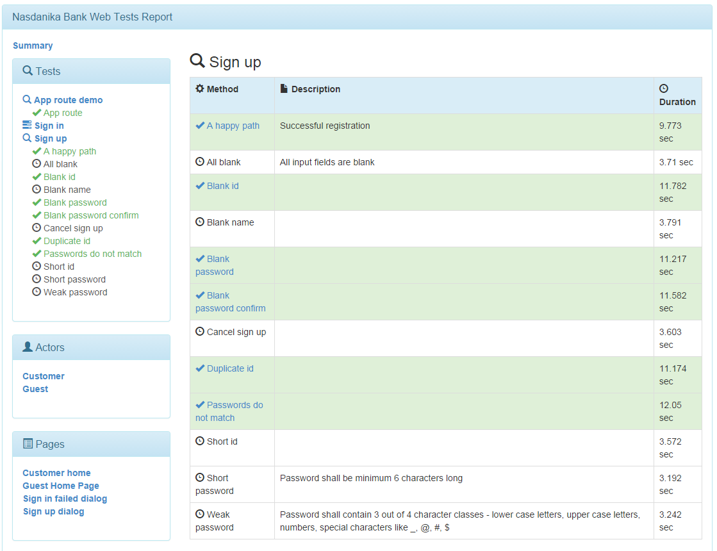
Test Class Details

Slide 9
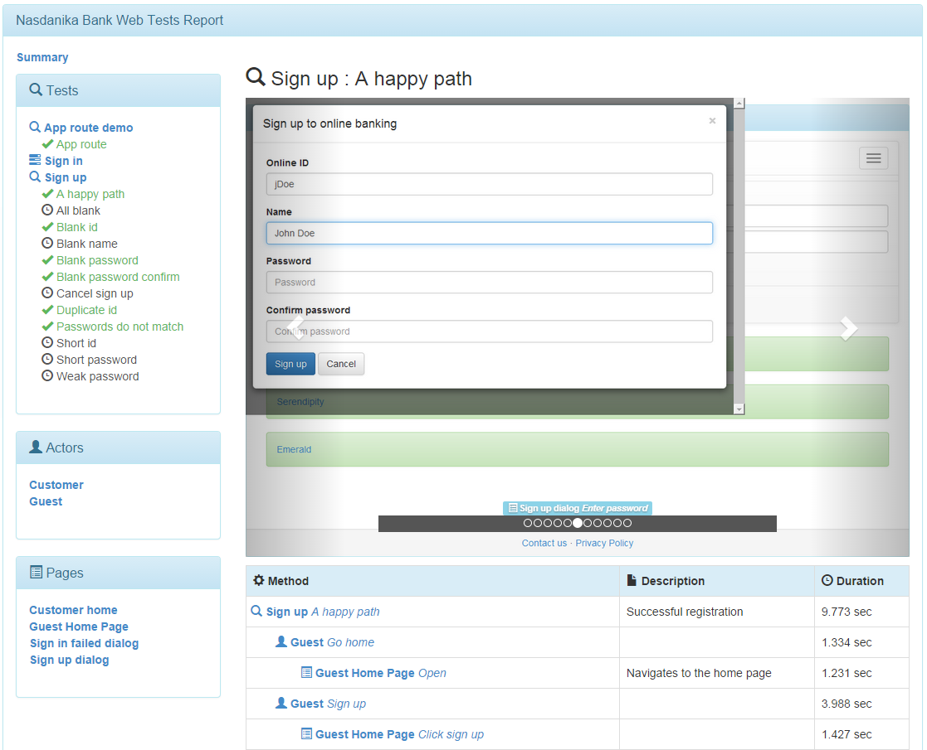
Test Method Details

Slide 10
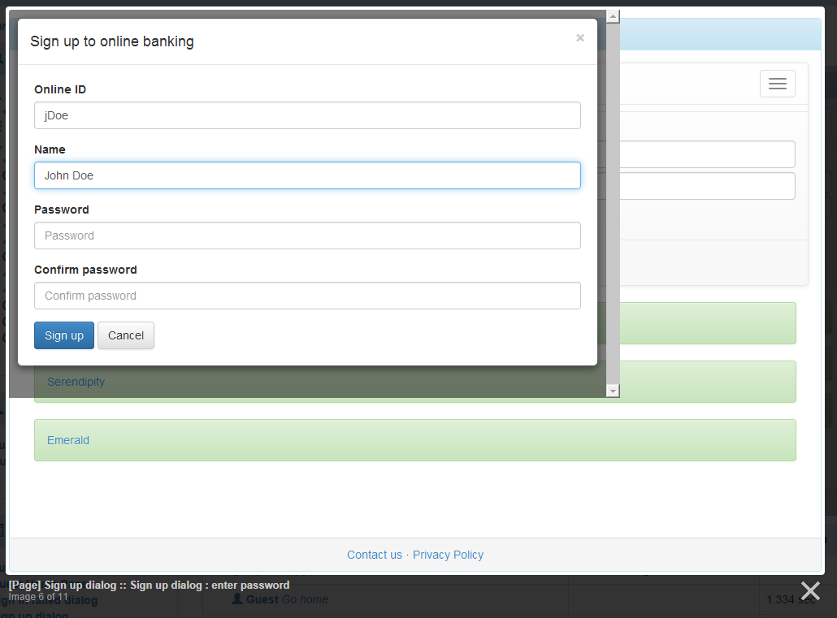
Slide Show
Opens by clicking on a screenshot in the carousel

Slide 11
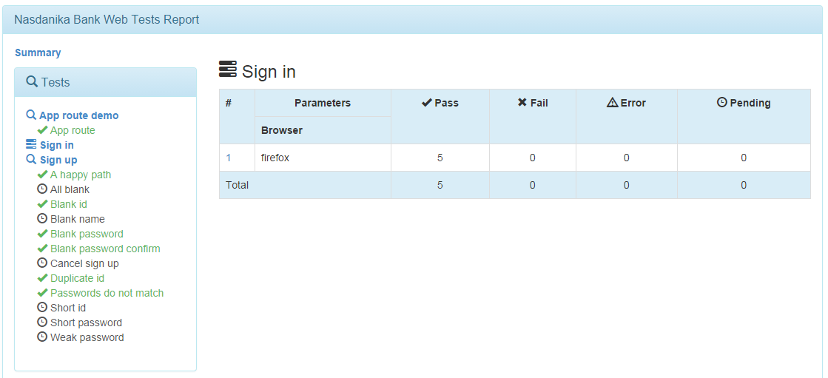
Parameterized Test

Slide 12
How It Works

Slide 13
Concepts
Test Case – A JUnit 4 test case class implementing WebTest interface.
Test Method – A JUnit test method. Uses Actor and Page specifications.
Page Specification – An interface abstracting test/actor code from the details of UI implementation.
Actor Specification – An interface abstracting tests from how a particular UI flow is implemented.
Page Implementation – An implementation of the Page Specification for a particular UI.
Actor Implementation – An implementation of the Actor Specification for a particular UI.
Page Factory – A factory interface for creating pages.
Actor Factory – A factory interface for creating actors.
Page Factory Implementation – An implementation of the page factory interface.
Actor Factory – An implementation of the actor factory interface.

Slide 14
Annotations (partial list)
Wait – Applies to test/actor/page methods and page classes to wait for certain conditions (e.g. visibility of an element) before executing method or initializing page class.
Waits – Composite Wait – a collection of Wait annotations connected by AND.
Screenshot – Configures when to take a screenshot and allows to specify delay.
ActorFactory – A field annotation for injecting actor factory OSGi service into a test class.
PageFactory – A field annotation for injecting page factory OSGi service into a test class.
Pending – Test methods with this annotation are not executed, but included into the report. Can be used if a test is implemented before actors and pages it uses.

Slide 15
Dependencies
Tests depend on actor/page specifications
Actor implementations depend on page specifications
Implementations are provided as OSGi services

Slide 16
Test execution
Factory injection
The framework finds actor/page factory OSGi service
The framework creates a proxy to intercept method invocations
The framework injects the proxy into the test class
Test method execution
The framework takes a screenshot before and after method invocation (configurable)
Test code uses the injected factory to create actors and/or pages
The factory proxy creates proxies for actors and pages and returns them to the test
When test code invokes actor/page proxies’ methods they
Honor @Wait and @Waits annotations if any
Invoke the corresponding actor/page method
Take screenshots before and after actor/page method execution
Report generation
Duplicate screenshots are eliminated
Screenshots are organized into slide shows
Test/actor/page method calls are organized into a tree

Slide 17
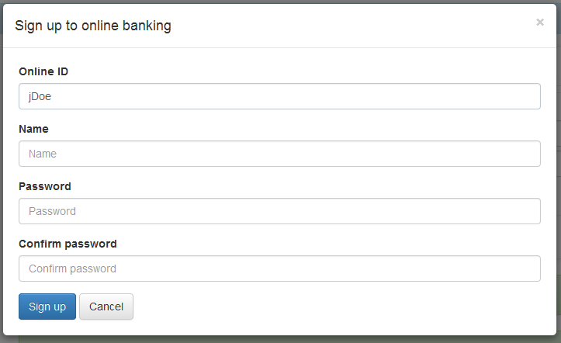
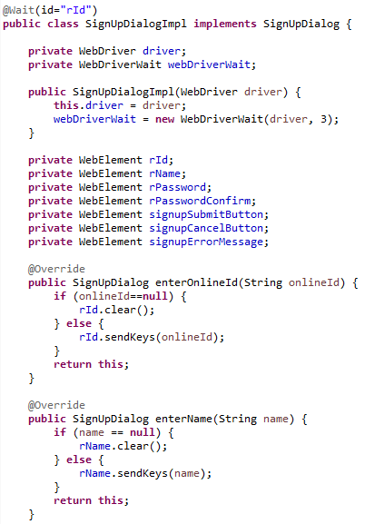
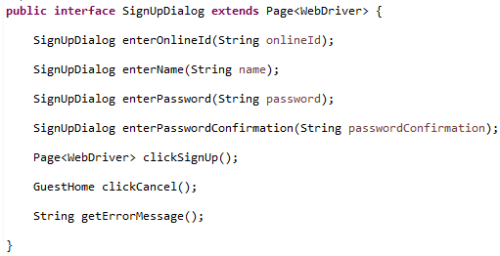
Page Class
Implementation fragment
Specification

Slide 18
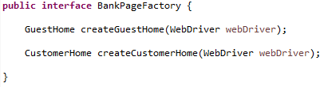
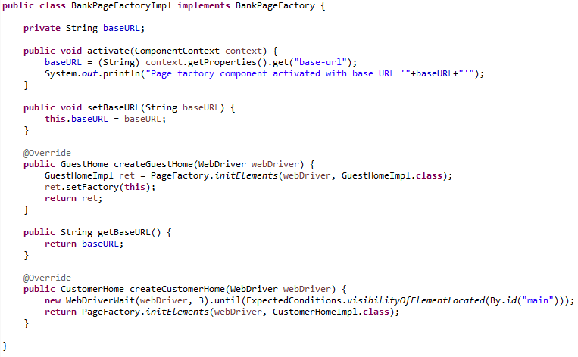
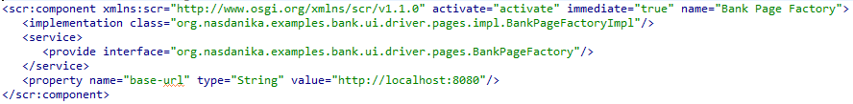
Page Factory
Specification
Implementation
Component definition

Slide 19
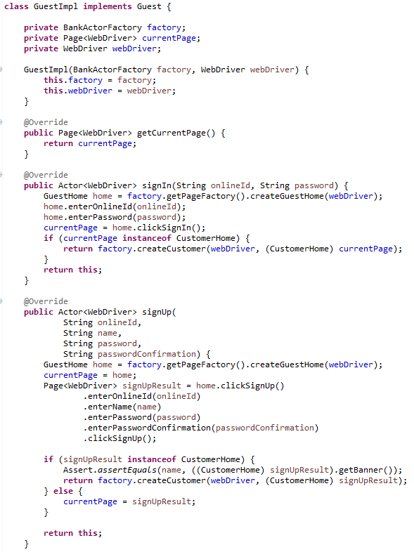
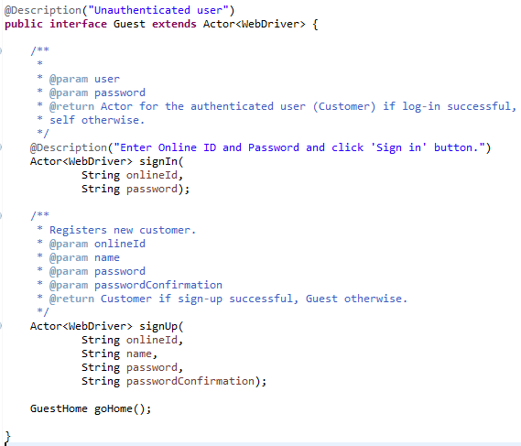
Actor Class
Implementation fragment
Specification

Slide 20
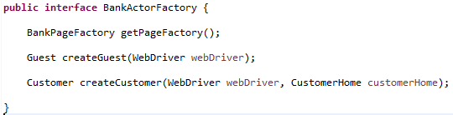
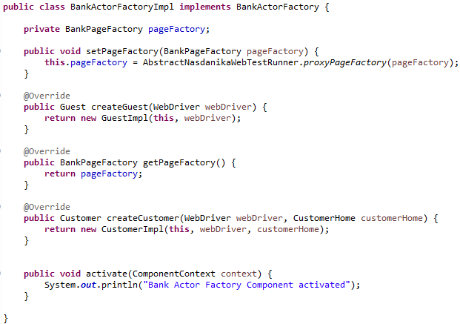
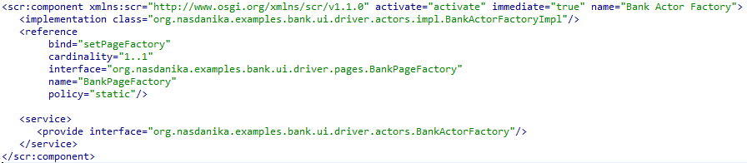
Actor Factory
Specification
Implementation
Page Factory is injected by OSGi
Component definition

Slide 21
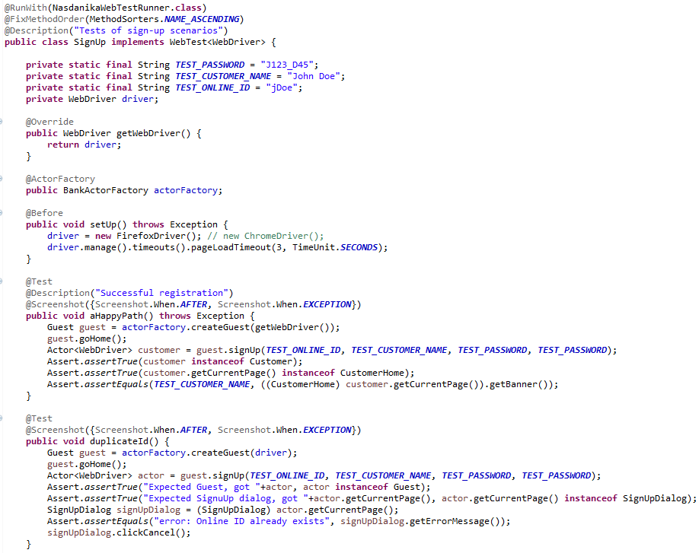
Test Class (fragment)
Factory is injected by the framework
Suppressing BEFORE screenshot (blank page)

Slide 22
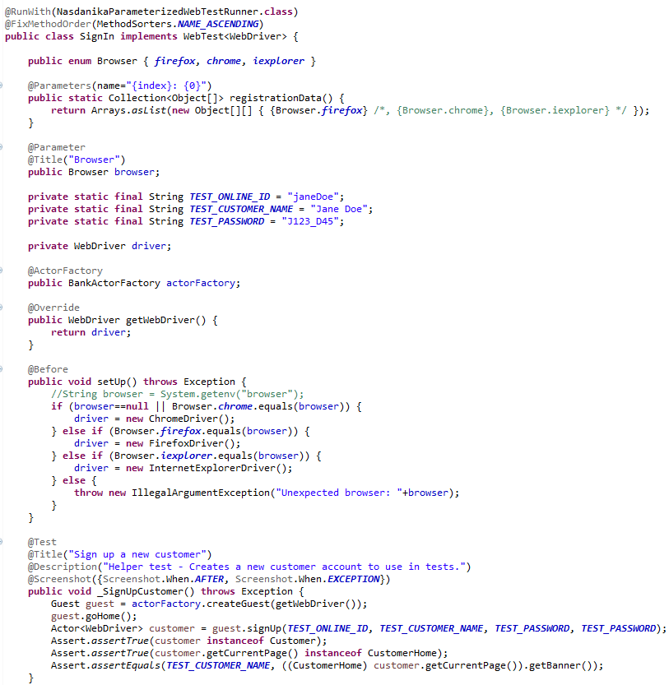
Parameterized Test (fragment)

Slide 23
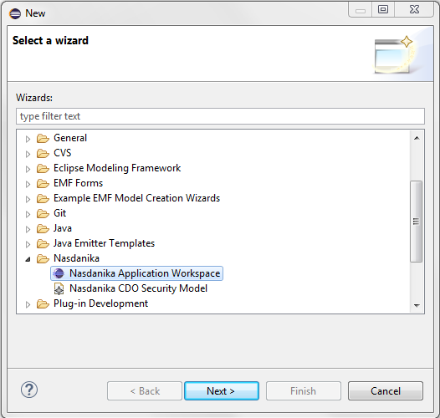
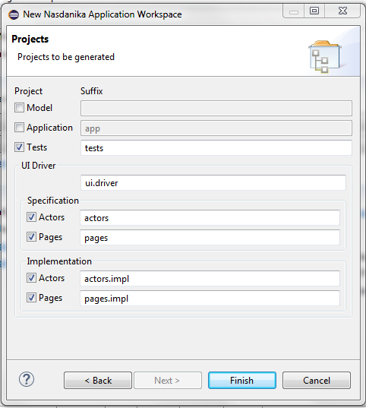
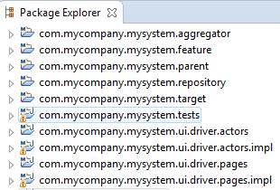
Set up workspace(s)
Install Nasdanika Workspace Wizard from http://www.nasdanika.org/server/repository
Install Maven Integration For Eclipse from the Eclipse Marketplace
Generate workspace projects – all in one workspace, or several workspaces, e.g. UI driver workspace and Tests project workspace

Slide 24
Value Proposition
Reuse
Tests – use with different actor/page implementations.
Actors/pages – use in different tests.
Some functionality (e.g. Log-in or Sign-up tests) can be extracted into shared libraries and reused between applications – facilitates consistent user experience across applications.
Separation of concerns and duties
Analysts/Designers – define tests and Actor/Page specifications.
Test developers – implement tests and actor classes.
Application developers – implement page classes.
Screenshots allow visual inspection by a wide community of stakeholders.
Test reports can be used as a training and documentation resource which is always up to date.

Slide 25
References
Wiki - https://github.com/Nasdanika/server/wiki/webtest
Sources - https://github.com/Nasdanika/server/tree/master/org.nasdanika.webtest
Example of UI driver - https://github.com/Nasdanika/examples-bank-ui-driver
Test application - https://github.com/Nasdanika/examples/tree/master/org.nasdanika.examples.bank.app.tests/src/org/nasdanika/examples/bank/app/tests
JavaDoc - http://www.nasdanika.org/server/apidocs/org/nasdanika/webtest/package-summary.html
Sample report - http://www.nasdanika.org/examples/test-report/#router/main/content/summary.html
P2 repository - http://www.nasdanika.org/repository

